Slide 1
What is Java
Java is a programming language and a platform.
Java is a high level, robust, object-oriented and secure programming language.
Platform: Any hardware or software environment in which a program runs, is known as a platform. Since Java has a runtime environment (JRE) and API, it is called a platform.

Slide 2
Application
According to Sun, 3 billion devices run Java. There are many devices where Java is currently used. Some of them are as follows:
Desktop Applications such as acrobat reader, media player, antivirus, etc.
Web Applications such as irctc.co.in, javatpoint.com, etc.
Enterprise Applications such as banking applications.
Mobile
Embedded System
Smart Card
Robotics
Games, etc.

Slide 3
Types of Java Applications
There are mainly 4 types of applications that can be created using Java programming:
1) Standalone Application
Standalone applications are also known as desktop applications or window-based applications. These are traditional software that we need to install on every machine. Examples of standalone application are Media player, antivirus, etc. AWT and Swing are used in Java for creating standalone applications.
2) Web Application
An application that runs on the server side and creates a dynamic page is called a web application. Currently, Servlet, JSP, Struts, Spring, Hibernate, JSF, etc. technologies are used for creating web applications in Java.

Slide 4
3) Enterprise Application
An application that is distributed in nature, such as banking applications, etc. is called enterprise application. It has advantages of the high-level security, load balancing, and clustering. In Java, EJB is used for creating enterprise applications.
4) Mobile Application
An application which is created for mobile devices is called a mobile application. Currently, Android and Java ME are used for creating mobile applications.

Slide 5
Java Version History
Many java versions have been released till now. The current stable release of Java is Java SE 10.
JDK Alpha and Beta (1995)
JDK 1.0 (23rd Jan 1996)
JDK 1.1 (19th Feb 1997)
J2SE 1.2 (8th Dec 1998)
J2SE 1.3 (8th May 2000)
J2SE 1.4 (6th Feb 2002)
J2SE 5.0 (30th Sep 2004)
Java SE 6 (11th Dec 2006)
Java SE 7 (28th July 2011)
Java SE 8 (18th March 2014)
Java SE 9 (21st Sep 2017)
Java SE 10 (20th March 2018)

Slide 6
Features of Java
The primary objective of Java programming language creation was to make it portable, simple and secure programming language.
A list of most important features of Java language is given below.
Simple
Object-Oriented
Portable
Platform independent
Secured
Robust
Architecture neutral
Interpreted
High Performance
Multithreaded
Distributed
Dynamic

Slide 7
Object-oriented
Java is an object-oriented programming language. Everything in Java is an object. Object-oriented means we organize our software as a combination of different types of objects that incorporates both data and behavior.
Object-oriented programming (OOPs) is a methodology that simplifies software development and maintenance by providing some rules.
Basic concepts of OOPs are:
Object
Class
Inheritance
Polymorphism
Abstraction
Encapsulation

Slide 8
First Java Program | Hello World Example
The requirement for Java Hello World Example
For executing any java program, you need to Install the JDK if you don't have installed it, download the JDK and install it.
Set path of the jdk/bin directory.
Create the java program
Compile and run the java program
Let's create the hello java program:
class Simple{
public static void main(String args[]){
System.out.println("Hello NIIT");
}
}

Slide 9
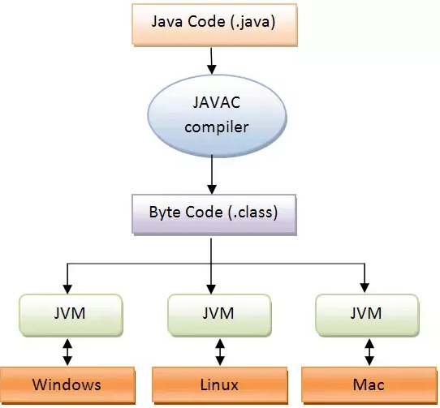
save this file as Simple.java
TO COMPILE javac Simple.java
TO EXECUTE/RUN java Simple
Compilation Flow:
When we compile Java program using javac tool, java compiler converts the source code into byte code.

Slide 10
Parameters used in First Java Program
Let's see what is the meaning of class, public, static, void, main, String[], System.out.println().
class keyword is used to declare a class in java.
public keyword is an access modifier which represents visibility. It means it is visible to all.
static is a keyword. If we declare any method as static, it is known as the static method. The core advantage of the static method is that there is no need to create an object to invoke the static method. The main method is executed by the JVM, so it doesn't require to create an object to invoke the main method. So it saves memory.
void is the return type of the method. It means it doesn't return any value.
main represents the starting point of the program.
String[] args is used for command line argument. We will learn it later.

Slide 11
System.out.println() is used to print statement. Here, System is a class, out is the object of PrintStream class, println() is the method of PrintStream class.
How many ways can we write a Java program
Valid java main method signature
public static void main(String[] args)
public static void main(String []args)
public static void main(String args[])
public static void main(String... args)
static public void main(String[] args)
public static final void main(String[] args)
final public static void main(String[] args)
final strictfp public static void main(String[] args)

Slide 12
Invalid java main method signature
public void main(String[] args)
static void main(String[] args)
public void static main(String[] args)
abstract public static void main(String[] args)

Slide 13
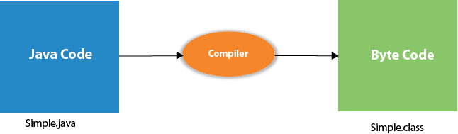
What happens at compile time?
At compile time, java file is compiled by Java Compiler (It does not interact with OS) and converts the java code into bytecode

Slide 14
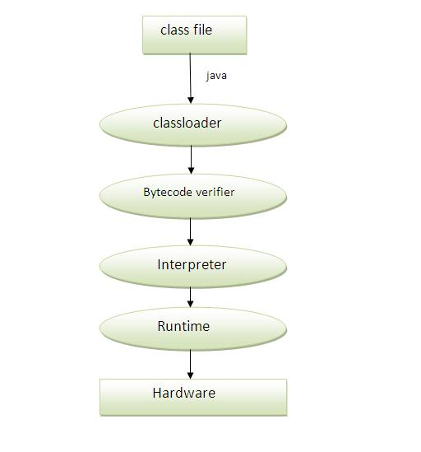
What happens at runtime?
At runtime, following steps are performed:

Slide 15
Difference between JDK, JRE, and JVM
JVM (Java Virtual Machine) is an abstract machine. It is called a virtual machine because it doesn't physically exist. It is a specification that provides a runtime environment in which Java bytecode can be executed.
The JVM performs the following main tasks:
Loads code
Verifies code
Executes code
Provides runtime environment
JVM provides definitions for the:
Memory area
Class file format
Register set
Garbage-collected heap
Fatal error reporting etc.

Slide 16
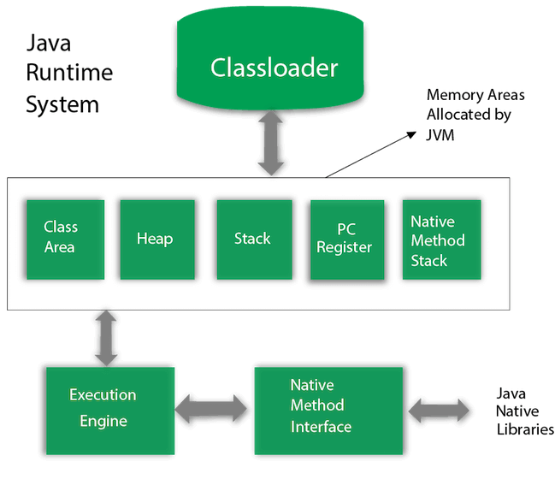
JVM Architecture

Slide 17
1) Classloader
Classloader is a subsystem of JVM which is used to load class files.
2) Class(Method) Area
Class(Method) Area stores per-class structures such as the runtime constant pool, field and method data, the code for methods.
3) Heap
It is the runtime data area in which objects are allocated.
4) Stack
Java Stack stores frames. It holds local variables and partial results, and plays a part in method invocation and return.

Slide 18
5) Program Counter Register
PC (program counter) register contains the address of the Java virtual machine instruction currently being executed.
6) Native Method Stack
It contains all the native methods used in the application.
7) Execution Engine
It contains:
A virtual processor
Interpreter: Read bytecode stream then execute the instructions.

Slide 19
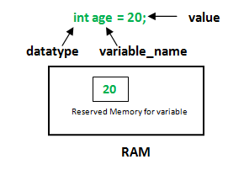
Java Variables
A variable is a container which holds the value while the java program is executed. A variable is assigned with a datatype.
Types of Variables
There are three types of variables in java:
local variable
instance variable
static variable
datatype: Type of data that can be stored in this variable. variable_name: Name given to the variable. value: It is the initial value stored in the variable.

Slide 20
1) Local Variable
A variable declared inside the body of the method is called local variable. You can use this variable only within that method and the other methods in the class aren't even aware that the variable exists.
A local variable cannot be defined with "static" keyword.
2) Instance Variable
A variable declared inside the class but outside the body of the method, is called instance variable. It is not declared as static.
It is called instance variable because its value is instance specific and is not shared among instances.
3) Static variable
A variable which is declared as static is called static variable. It cannot be local.

Slide 21
Example to understand the types of variables in java
class A{
int data=50;//instance variable
static int m=100;//static variable
void method(){
int n=90;//local variable
}
}//end of class

Slide 22
Java Variable Example: Add Two Numbers
public class Simple{
public static void main(String[] args){
int a=10;
int b=10;
int c=a+b;
System.out.println(c);
}}

Slide 23
Final in Java
A final variable in Java can be assigned a value only once, we can assign a value either in declaration or later.
final int i = 10;
i = 30; // Error because i is final
A blank final variable in Java is a final variable that is not initialized during declaration. Below is a simple example of blank final.
// A simple blank final example
final int i;
i = 30;

Slide 24
Java Identifiers
In programming languages, identifiers are used for identification purpose. In Java, an identifier can be a class name, method name, variable name or a label. For example :
public class Test
{
public static void main(String args[])
{
int a=11;
}
}
In the above java code, we have 5 identifiers namely :
Test : class name.
main : method name.
String : predefined class name.
args : variable name.
a : variable name.

Slide 25
Rules for defining Java Identifiers
The only allowed characters for identifiers are all alphanumeric characters([A-Z],[a-z],[0-9]), ‘$‘(dollar sign) and ‘_‘ (underscore).For example “geek@” is not a valid java identifier as it contain ‘@’ special character.
Identifiers should not start with digits([0-9]). For example “123geeks” is a not a valid java identifier.
Java identifiers are case-sensitive.
There is no limit on the length of the identifier but it is advisable to use an optimum length of 4 – 15 letters only.
Reserved Words can’t be used as an identifier. For example “int while = 20;” is an invalid statement as while is a reserved word. There are 53 reserved words in Java.

Slide 26
Data Types in Java
Data types specify the different sizes and values that can be stored in the variable. There are two types of data types in Java:
1. Primitive data types: The primitive data types include boolean, char, byte, short, int, long, float and double.
There are 8 types of primitive data types:
boolean data type
byte data type
char data type
short data type
int data type
long data type
float data type
double data type

Slide 27
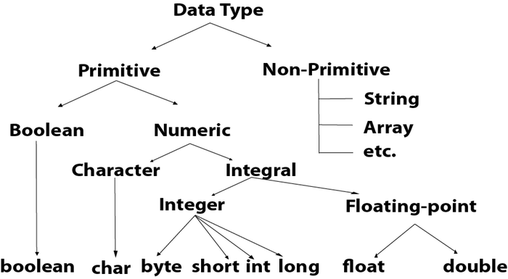
2. Non-primitive data types: The non-primitive data types include Classes, Interfaces, and Arrays.

Slide 28
Operators in java :
Operator in java is a symbol that is used to perform operations. For example: +, -, *, / etc.
There are many types of operators in java which are given below:
Unary Operator,
Arithmetic Operator,
Shift Operator,
Relational Operator,
Bitwise Operator,
Logical Operator,
Ternary Operator and
Assignment Operator.

Slide 29
Operator Type | Category | Precedence
Unary | postfix | expr++ expr--
 | prefix | ++expr --expr +expr -expr ~ !
Arithmetic | multiplicative | * / %
 | additive | + -
Shift | shift | << >> >>>
Relational | comparison | < > <= >= instanceof
 | equality | == !=
Bitwise | bitwise AND | &
 | bitwise exclusive OR | ^
 | bitwise inclusive OR | |
Logical | logical AND | &&
 | logical OR | ||
Ternary | ternary | ? :
Assignment | assignment | = += -= *= /= %= &= ^= |= <<= >>= >>>=

Slide 30
Java Unary Operator
The Java unary operators require only one operand. Unary operators are used to perform various operations i.e.:
incrementing/decrementing a value by one
negating an expression
inverting the value of a Boolean
Java Unary Operator Example: ++ and --
public class OperatorExample{
public static void main(String args[]){
int x=10;
System.out.println(x++);//10 (11)
System.out.println(++x);//12
System.out.println(x--);//12 (11)
System.out.println(--x);//10
}}

Slide 31
Java Unary Operator Example 2: ++ and –-
public class OperatorExample{
public static void main(String args[]){
int a=10;
int b=10;
System.out.println(a++ + ++a);//10+12=22
System.out.println(b++ + b++);//10+11=21
}}

Slide 32
Java Unary Operator Example: ~ and !
public class OperatorExample{
public static void main(String args[]){
int a=10;
int b=-10;
boolean c=true;
boolean d=false;
System.out.println(~a);//-11 (minus of total positive value which starts from 0)
System.out.println(~b);//9 (positive of total minus, positive starts from 0)
System.out.println(!c);//false (opposite of boolean value)
System.out.println(!d);//true
}
}

Slide 33
Java Arithmetic Operators
Java arithmetic operators are used to perform addition, subtraction, multiplication, and division. They act as basic mathematical operations.
Java Arithmetic Operator Example
public class OperatorExample{
public static void main(String args[]){
int a=10;
int b=5;
System.out.println(a+b);//15
System.out.println(a-b);//5
System.out.println(a*b);//50
System.out.println(a/b);//2
System.out.println(a%b);//0
}}

Slide 34
Java Arithmetic Operator Example: Expression
class OperatorExample{
public static void main(String args[]){
System.out.println(10*10/5+3-1*4/2); //21
}}
Java Left Shift Operator
The Java left shift operator << is used to shift all of the bits in a value to the left side of a specified number of times.
public class OperatorExample{
public static void main(String args[]){
System.out.println(10<<2);//10*2^2=10*4=40
System.out.println(10<<3);//10*2^3=10*8=80
System.out.println(20<<2);//20*2^2=20*4=80
System.out.println(15<<4);//15*2^4=15*16=240
}}

Slide 35
Java Right Shift Operator
The Java right shift operator >> is used to move left operands value to right by the number of bits specified by the right operand.
Java Right Shift Operator Example
public class OperatorExample{
public static void main(String args[]){
System.out.println(10>>2);//10/2^2=10/4=2
System.out.println(20>>2);//20/2^2=20/4=5
System.out.println(20>>3);//20/2^3=20/8=2
}}

Slide 36
Java AND Operator Example: Logical && and Bitwise &
The logical && operator doesn't check second condition if first condition is false. It checks second condition only if first one is true.
The bitwise & operator always checks both conditions whether first condition is true or false.
public class OperatorExample{
public static void main(String args[]){
int a=10;
int b=5;
int c=20;
System.out.println(a<b&&a<c);//false && true = false
System.out.println(a<b&a<c);//false & true = false
}}

Slide 37
Java AND Operator Example: Logical && vs Bitwise &
public class OperatorExample{
public static void main(String args[]){
int a=10;
int b=5;
int c=20;
System.out.println(a<b&&a++<c);//false && true = false
System.out.println(a);//10 because second condition is not checked
System.out.println(a<b&a++<c);//false && true = false
System.out.println(a);//11 because second condition is checked
}}

Slide 38
Java OR Operator Example: Logical || and Bitwise |
The logical || operator doesn't check second condition if first condition is true. It checks second condition only if first one is false.
The bitwise | operator always checks both conditions whether first condition is true or false.
public class OperatorExample{
public static void main(String args[]){
int a=10;
int b=5;
int c=20;
System.out.println(a>b||a<c);//true || true = true
System.out.println(a>b|a<c);//true | true = true
//|| vs |
System.out.println(a>b||a++<c);//true || true = true
System.out.println(a);//10 because second condition is not checked
System.out.println(a>b|a++<c);//true | true = true
System.out.println(a);//11 because second condition is checked
}}

Slide 39
Java Ternary Operator
Java Ternary operator is used as one liner replacement for if-then-else statement and used a lot in java programming. it is the only conditional operator which takes three operands.
Java Ternary Operator Example
class OperatorExample{
public static void main(String args[]){
int a=2;
int b=5;
int min=(a<b)?a:b;
System.out.println(min);
}}

Slide 40
If-else Statement
The Java if statement is used to test the condition. It checks boolean condition: true or false. There are various types of if statement in java.
if statement
if-else statement
if-else-if ladder
nested if statement
public class IfExample {
public static void main(String[] args) {
//defining an 'age' variable
int age=20;
//checking the age
if(age>18){
System.out.print("Age is greater than 18");
}
}
}

Slide 41
if-else Statement
The Java if-else statement also tests the condition. It executes the if block if condition is true otherwise else block is executed.
public class IfElseExample {
public static void main(String[] args) {
//defining a variable
int number=13;
//Check if the number is divisible by 2 or not
if(number%2==0){
System.out.println("even number");
}else{
System.out.println("odd number");
} }}

Slide 42
public class IfElseIfExample {
public static void main(String[] args) {
int marks=65;
if(marks<50){
System.out.println("fail");
}
else if(marks>=50 && marks<60){
System.out.println("D grade");
}
else if(marks>=60 && marks<70){
System.out.println("C grade");
}
else if(marks>=70 && marks<80){
System.out.println("B grade");
}
else if(marks>=80 && marks<90){
System.out.println("A grade");
}else if(marks>=90 && marks<100){
System.out.println("A+ grade");
}else{
System.out.println("Invalid!");
} }}

Slide 43
Nested if statement
The nested if statement represents the if block within another if block. Here, the inner if block condition executes only when outer if block condition is true.
public class JavaNestedIfExample {
public static void main(String[] args) {
//Creating two variables for age and weight
int age=20;
int weight=80;
//applying condition on age and weight
if(age>=18){
if(weight>50){
System.out.println("You are eligible to donate blood");
}
}
}}

Slide 44
Switch Statement
The Java switch statement executes one statement from multiple conditions. It is like if-else-if ladder statement. The switch statement works with byte, short, int, long, enum types, String and some wrapper types like Byte, Short, Int, and Long. Since Java 7, you can use strings in the switch statement
In other words, the switch statement tests the equality of a variable against multiple values.
Points to Remember
There can be one or N number of case values for a switch expression.
The case value must be of switch expression type only. The case value must be literal or constant. It doesn't allow variables.
The case values must be unique. In case of duplicate value, it renders compile-time error.
The Java switch expression must be of byte, short, int, long (with its Wrapper type), enums and string.
Each case statement can have a break statement which is optional. When control reaches to the break statement, it jumps the control after the switch expression. If a break statement is not found, it executes the next case.

Slide 45
public class SwitchExample {
public static void main(String[] args) {
//Declaring a variable for switch expression
int number=20;
//Switch expression
switch(number){
//Case statements
case 10: System.out.println("10");
break;
case 20: System.out.println("20");
break;
case 30: System.out.println("30");
break;
//Default case statement
default:System.out.println("Not in 10, 20 or 30");
}
}
}

Slide 46
public class SwitchMonthExample {
public static void main(String[] args) {
//Specifying month number
int month=7;
String monthString="";
//Switch statement
switch(month){
//case statements within the switch block
case 1: monthString="1 - January";
break;
case 2: monthString="2 - February";
break;
case 3: monthString="3 - March";
break;
case 4: monthString="4 - April";
break;
case 5: monthString="5 - May";
break;
case 6: monthString="6 - June";
break;
case 7: monthString="7 - July";
break;
case 8: monthString="8 - August";
break;
case 9: monthString="9 - September";
break;
case 10: monthString="10 - October";
break;
case 11: monthString="11 - November";
break;
case 12: monthString="12 - December";
break;
default:System.out.println("Invalid Month!");
}
//Printing month of the given number
System.out.println(monthString);
}
}

Slide 47
Java Switch Statement is fall-through
The Java switch statement is fall-through. It means it executes all statements after the first match if a break statement is not present.
public class SwitchExample2 {
public static void main(String[] args) {
int number=20;
//switch expression with int value
switch(number){
//switch cases without break statements
case 10: System.out.println("10");
case 20: System.out.println("20");
case 30: System.out.println("30");
default:System.out.println("Not in 10, 20 or 30");
}
}
}

Slide 48
Loops in Java
In programming languages, loops are used to execute a set of instructions/functions repeatedly when some conditions become true. There are three types of loops in java.
for loop
The Java for loop is a control flow statement that iterates a part of the programs multiple times. If the number of iteration is fixed, it is recommended to use for loop. public class ForExample {
public class ForExample {
public static void main(String[] args) {
//Code of Java for loop
for(int i=1;i<=10;i++){
System.out.println(i);
}
}
}

Slide 49
Java Infinitive For Loop
If you use two semicolons ;; in the for loop, it will be infinitive for loop.
Syntax:
public class ForExample {
public static void main(String[] args) {
//Using no condition in for loop
for(;;){
System.out.println("infinitive loop");
}
}
}
press ctrl+c to exit from the program

Slide 50
while loop
The Java while loop is a control flow statement that executes a part of the programs repeatedly on the basis of given boolean condition. If the number of iteration is not fixed, it is recommended to use while loop.
public class WhileExample {
public static void main(String[] args) {
int i=1;
while(i<=10){
System.out.println(i);
i++;
}
}
}

Slide 51
Infinitive While Loop
If you pass true in the while loop, it will be infinitive while loop.
public class WhileExample2 {
public static void main(String[] args) {
while(true){
System.out.println("infinitive while loop");
}
}
}

Slide 52
do-while loop
The Java do while loop is a control flow statement that executes a part of the programs at least once anIf the number of iteration is not fixed and you must have to execute the loop at least once, it is recommended to use the do-while loop.d the further execution depends upon the given boolean condition.
public class DoWhileExample {
public static void main(String[] args) {
int i=1;
do{
System.out.println(i);
i++;
}while(i<=10);
}
}

Slide 53
Infinitive do-while Loop
If you pass true in the do-while loop, it will be infinitive do-while loop.
public class DoWhileExample2 {
public static void main(String[] args) {
do{
System.out.println("infinitive do while loop");
}while(true);
}
}

Slide 54
Break Statement
When a break statement is encountered inside a loop, the loop is immediately terminated and the program control resumes at the next statement following the loop.
The Java break is used to break loop or switch statement. It breaks the current flow of the program at specified condition. In case of inner loop, it breaks only inner loop.
We can use Java break statement in all types of loops such as for loop, while loop and do-while loop.
Syntax:
jump-statement;
break;

Slide 55
public class BreakExample {
public static void main(String[] args) {
//using for loop
for(int i=1;i<=10;i++){
if(i==5){
//breaking the loop
break;
}
System.out.println(i);
}
}
}

Slide 56
Break Statement with Inner Loop
It breaks inner loop only if you use break statement inside the inner loop.
Example:
//Java Program to illustrate the use of break statement
//inside an inner loop
public class BreakExample2 {
public static void main(String[] args) {
//outer loop
for(int i=1;i<=3;i++){
//inner loop
for(int j=1;j<=3;j++){
if(i==2&&j==2){
//using break statement inside the inner loop
break;
}
System.out.println(i+" "+j);
}
}
}
}

Slide 57
Break Statement in while loop
Example:
//Java Program to demonstrate the use of break statement
//inside the while loop.
public class BreakWhileExample {
public static void main(String[] args) {
//while loop
int i=1;
while(i<=10){
if(i==5){
//using break statement
i++;
break;//it will break the loop
}
System.out.println(i);
i++;
} }}

Slide 58
Break Statement in do-while loop
Example:
//Java Program to demonstrate the use of break statement
//inside the Java do-while loop.
public class BreakDoWhileExample {
public static void main(String[] args) {
//declaring variable
int i=1;
//do-while loop
do{
if(i==5){
//using break statement
i++;
break;//it will break the loop
}
System.out.println(i);
i++;
}while(i<=10);
} }

Slide 59
Continue Statement
The continue statement is used in loop control structure when you need to jump to the next iteration of the loop immediately. It can be used with for loop or while loop.
The Java continue statement is used to continue the loop. It continues the current flow of the program and skips the remaining code at the specified condition. In case of an inner loop, it continues the inner loop only.
We can use Java continue statement in all types of loops such as for loop, while loop and do-while loop.
Syntax:
jump-statement;
continue;

Slide 60
public class ContinueExample {
public static void main(String[] args) {
//for loop
for(int i=1;i<=10;i++){
if(i==5){
//using continue statement
continue;//it will skip the rest statement
}
System.out.println(i);
}
}
}

Slide 61
Continue Statement with Inner Loop
It continues inner loop only if you use the continue statement inside the inner loop.
public class ContinueExample2 {
public static void main(String[] args) {
//outer loop
for(int i=1;i<=3;i++){
//inner loop
for(int j=1;j<=3;j++){
if(i==2&&j==2){
//using continue statement inside inner loop
continue;
}
System.out.println(i+" "+j);
} }}}

Slide 62
Continue Statement with Labeled For Loop
We can use continute statement with a label. This feature is introduced since JDK 1.5. So, we can continue any loop in Java now whether it is outer loop or inner.
Example:
//Java Program to illustrate the use of continue statement
//with label inside an inner loop to continue outer loop
public class ContinueExample3 {
public static void main(String[] args) {
aa:
for(int i=1;i<=3;i++){
bb:
for(int j=1;j<=3;j++){
if(i==2&&j==2){
//using continue statement with label
continue aa;
}
System.out.println(i+" "+j);
} } } }

Slide 63
Continue Statement in while loop
Example:
//Java Program to demonstrate the use of continue statement
//inside the while loop.
public class ContinueWhileExample {
public static void main(String[] args) {
//while loop
int i=1;
while(i<=10){
if(i==5){
//using continue statement
i++;
continue;//it will skip the rest statement
}
System.out.println(i);
i++;
}
}
}

Slide 64
Continue Statement in do-while loop
Example:
//Java Program to demonstrate the use of continue statement
//inside the Java do-while loop.
public class ContinueDoWhileExample {
public static void main(String[] args) {
//declaring variable
int i=1;
//do-while loop
do{
if(i==5){
//using continue statement
i++;
continue;//it will skip the rest statement
}
System.out.println(i);
i++;
}while(i<=10);
} }

Slide 65
Types of Java Comments
There are 3 types of comments in java.
Single Line Comment
//This is single line comment
Multi Line Comment
/*
multi line
comment
*/
Documentation Comment
/**
documentation
comment
*/

Slide 66
Java Naming conventions
Java naming convention is a rule to follow as you decide what to name your identifiers such as class, package, variable, constant, method, etc
Advantage of naming conventions in java
The following are the key rules that must be followed by every identifier:
The name must not contain any white spaces.
The name should not start with special characters like & (ampersand), $ (dollar), _ (underscore).

Slide 67
Class
It should start with the uppercase letter.
It should be a noun such as Color, Button, System, Thread, etc.
Use appropriate words, instead of acronyms.
Example: -
public class Employee
{
//code snippet
}

Slide 68
Interface
It should start with the uppercase letter.
It should be an adjective such as Runnable, Remote, ActionListener.
Use appropriate words, instead of acronyms.
Example: -
interface Printable
{
//code snippet
}

Slide 69
Method
It should start with lowercase letter.
It should be a verb such as main(), print(), println().
If the name contains multiple words, start it with a lowercase letter followed by an uppercase letter such as actionPerformed().
Example:-
class Employee
{
//method
void draw()
{
//code snippet
}
}

Slide 70
Variable
It should start with a lowercase letter such as id, name.
It should not start with the special characters like & (ampersand), $ (dollar), _ (underscore).
If the name contains multiple words, start it with the lowercase letter followed by an uppercase letter such as firstName, lastName.
Avoid using one-character variables such as x, y, z.
Example :-
class Employee
{
//variable
int id;
//code snippet
}

Slide 71
Package
It should be a lowercase letter such as java, lang.
If the name contains multiple words, it should be separated by dots (.) such as java.util, java.lang.
Example :-
package Mukesh.kumar.aaryaa; //package
class Employee
{
//code snippet
}

Slide 72
What is an object in Java
An object has three characteristics:
State:represents the data (value) of an object.
Behavior: represents the behavior (functionality) of an object such as deposit, withdraw, etc.
Identity: An object identity is typically implemented via a unique ID. The value of the ID is not visible to the external user. However, it is used internally by the JVM to identify each object uniquely.
Object Definitions:
An object is a real-world entity.
An object is a runtime entity.
The object is an entity which has state and behavior.
The object is an instance of a class.

Slide 73
What is a class in Java
A class is a group of objects which have common properties. It is a template or blueprint from which objects are created. It is a logical entity. It can't be physical.
A class in Java can contain:
Fields
Methods
Constructors
Blocks
Nested class and interface
Method in Java
In Java, a method is like a function which is used to expose the behavior of an object.
Advantage of Method
Code Reusability
Code Optimization

Slide 74
new keyword in Java
The new keyword is used to allocate memory at runtime. All objects get memory in Heap memory area.
we created a Student class which has two data members id and name. We are creating the object of the Student class by new keyword and printing the object's value.
Here, we are creating a main() method inside the class.

Slide 75
Object and Class Example: main within the class
In this example, we have created a Student class which has two data members id and name. We are creating the object of the Student class by new keyword and printing the object's value.
public class Student{
//defining fields
int id;//field or data member or instance variable
String name;
//creating main method inside the Student class
public static void main(String args[]){
//Creating an object or instance
Student s1=new Student();//creating an object of Student
//Printing values of the object
System.out.println(s1.id);//accessing member through reference variable
System.out.println(s1.name);
}
}

Slide 76
3 Ways to initialize object
There are 3 ways to initialize object in java.
By reference variable
By method
By constructor
Initialization through reference
class Student{
int id;
String name;
}
class TestStudent2{
public static void main(String args[]){
Student s1=new Student();
s1.id=101;
s1.name="Sonoo";
System.out.println(s1.id+" "+s1.name);//printing members with a white space
} }

Slide 77
We can also create multiple objects and store information in it through reference variable
class Student{
int id;
String name;
}
class TestStudent3{
public static void main(String args[]){
//Creating objects
Student s1=new Student();
Student s2=new Student();
//Initializing objects
s1.id=101;
s1.name="Sonoo";
s2.id=102;
s2.name="Amit";
//Printing data
System.out.println(s1.id+" "+s1.name);
System.out.println(s2.id+" "+s2.name);
} }

Slide 78
Initialization through method
In this example, we are creating the two objects of Student class and initializing the value to these objects by invoking the insertRecord method.
class Student{
int rollno;
String name;
void insertRecord(int r, String n){
rollno=r;
name=n;
}
void displayInformation(){System.out.println(rollno+" "+name);}
}
class TestStudent4{
public static void main(String args[]){
Student s1=new Student();
Student s2=new Student();
s1.insertRecord(111,"Karan");
s2.insertRecord(222,"Aryan");
s1.displayInformation();
s2.displayInformation();
} }

Slide 79
Initialization through a constructor
class Employee{
int id;
String name;
float salary;
void insert(int i, String n, float s) {
id=i;
name=n;
salary=s;
}
void display(){System.out.println(id+" "+name+" "+salary);}
}
public class TestEmployee {
public static void main(String[] args) {
Employee e1=new Employee();
Employee e2=new Employee();
Employee e3=new Employee();
e1.insert(101,"ajeet",45000);
e2.insert(102,"irfan",25000);
e3.insert(103,"nakul",55000);
e1.display();
e2.display();
e3.display();
} }

Slide 80
What are the different ways to create an object in Java?
There are many ways to create an object in java. They are:
By new keyword
By newInstance() method
By clone() method
By deserialization
By factory method etc.

Slide 81
Constructors in Java
In Java, a constructor is a block of codes similar to the method. It is called when an instance of the object is created, and memory is allocated for the object.
When is a constructor called
Every time an object is created using new() keyword, at least one constructor is called. It calls a default constructor.
Rules for creating Java constructor
There are two rules defined for the constructor.
Constructor name must be the same as its class name
A Constructor must have no explicit return type
A Java constructor cannot be abstract, static, final, and synchronized

Slide 82
Types of Java constructors
There are two types of constructors in Java:
Default constructor (no-arg constructor)
Parameterized constructor
Example of default constructor
we are creating the no-arg constructor in the Bike class.
class Bike1{
//creating a default constructor
Bike1(){System.out.println("Bike is created");}
//main method
public static void main(String args[]){
//calling a default constructor
Bike1 b=new Bike1();
} }

Slide 83
Parameterized Constructor
A constructor which has a specific number of parameters is called a parameterized constructor.
Why use the parameterized constructor?
The parameterized constructor is used to provide different values to the distinct objects. However, you can provide the same values also.

Slide 84
class Student4{
int id;
String name;
//creating a parameterized constructor
Student4(int i,String n){
id = i;
name = n;
}
//method to display the values
void display(){System.out.println(id+" "+name);}
public static void main(String args[]){
//creating objects and passing values
Student4 s1 = new Student4(111,"Karan");
Student4 s2 = new Student4(222,"Aryan");
//calling method to display the values of object
s1.display();
s2.display();
} }

Slide 85
Java static keyword
The static keyword in Java is used for memory management mainly. We can apply java static keyword with variables, methods, blocks and nested class. The static keyword belongs to the class than an instance of the class.
The static can be:
Variable (also known as a class variable)
Method (also known as a class method)
Block
Nested class
Java static variable
If you declare any variable as static, it is known as a static variable.
The static variable can be used to refer to the common property of all objects (which is not unique for each object), for example, the company name of employees, college name of students, etc.
The static variable gets memory only once in the class area at the time of class loading.

Slide 86
class Student{
int rollno;//instance variable
String name;
static String college ="ITS";//static variable
//constructor
Student(int r, String n){
rollno = r;
name = n;
}
//method to display the values
void display (){System.out.println(rollno+" "+name+" "+college);}
}
//Test class to show the values of objects
public class TestStaticVariable1{
public static void main(String args[]){
Student s1 = new Student(111,"Karan");
Student s2 = new Student(222,"Aryan");
//we can change the college of all objects by the single line of code
//Student.college="BBDIT";
s1.display();
s2.display();
} }

Slide 87
2) Java static method
If you apply static keyword with any method, it is known as static method.
A static method belongs to the class rather than the object of a class.
A static method can be invoked without the need for creating an instance of a class.
A static method can access static data member and can change the value of it.

Slide 88
//Java Program to demonstrate the use of a static method.
class Student{
int rollno;
String name;
static String college = "ITS";
//static method to change the value of static variable
static void change(){
college = "BBDIT";
}
//constructor to initialize the variable
Student(int r, String n){
rollno = r;
name = n;
}
//method to display values
void display(){System.out.println(rollno+" "+name+" "+college);}
}
//Test class to create and display the values of object
public class TestStaticMethod{
public static void main(String args[]){
Student.change();//calling change method
//creating objects
Student s1 = new Student(111,"Karan");
Student s2 = new Student(222,"Aryan");
Student s3 = new Student(333,"Sonoo");
//calling display method
s1.display();
s2.display();
s3.display();
} }

Slide 89
Restrictions for the static method
There are two main restrictions for the static method. They are:
The static method can not use non static data member or call non-static method directly.
this and super cannot be used in static context.
class A{
int a=40;//non static
public static void main(String args[]){
System.out.println(a);
}
}
Output: Compile Time error

Slide 90
Java static keyword
The static keyword in Java is used for memory management mainly. We can apply java static keyword with variables, methods, blocks and nested class. The static keyword belongs to the class than an instance of the class.
The static can be:
Variable (also known as a class variable)
Method (also known as a class method)
Block
Nested class

Slide 91
Java static variable
If you declare any variable as static, it is known as a static variable.
The static variable can be used to refer to the common property of all objects (which is not unique for each object), for example, the company name of employees, college name of students, etc.
The static variable gets memory only once in the class area at the time of class loading.
Advantages of static variable
It makes your program memory efficient (i.e., it saves memory).

Slide 92
Understanding the problem without static variable
class Student{
int rollno;
String name;
String college="ITS";
}

Slide 93
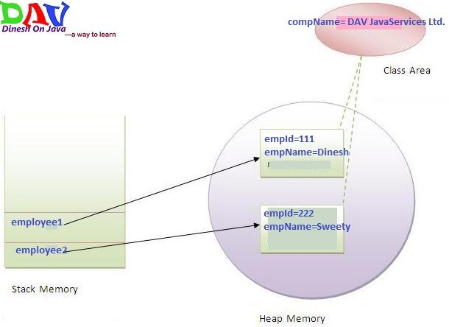

Slide 94
class Student{
int rollno;//instance variable
String name;
static String college =“NIIT";//static variable
//constructor
Student(int r, String n){
rollno = r;
name = n;
}
//method to display the values
void display (){System.out.println(rollno+" "+name+" "+college);}
}
//Test class to show the values of objects
public class TestStaticVariable1{
public static void main(String args[]){
Student s1 = new Student(111,“mayank");
Student s2 = new Student(222,“pooja");
//we can change the college of all objects by the single line of code
//Student.college=“NIIT";
s1.display();
s2.display();
}
}

Slide 95
this keyword in java
There can be a lot of usage of java this keyword. In java, this is a reference variable that refers to the current object.
Usage of java this keyword
Here is given the 6 usage of java this keyword.
this can be used to refer current class instance variable.
this can be used to invoke current class method (implicitly)
this() can be used to invoke current class constructor.
this can be passed as an argument in the method call.
this can be passed as argument in the constructor call.
this can be used to return the current class instance from the method.

Slide 96
Java static method
If you apply static keyword with any method, it is known as static method.
A static method belongs to the class rather than the object of a class.
A static method can be invoked without the need for creating an instance of a class.
A static method can access static data member and can change the value of it.

Slide 97
class Student{
int rollno;
String name;
static String college = "ITS";
//static method to change the value of static variable
static void change(){
college = "BBDIT";
}
//constructor to initialize the variable
Student(int r, String n){
rollno = r;
name = n;
}
//method to display values
void display(){System.out.println(rollno+" "+name+" "+college);}
}
//Test class to create and display the values of object
public class TestStaticMethod{
public static void main(String args[]){
Student.change();//calling change method
//creating objects
Student s1 = new Student(111,"Karan");
Student s2 = new Student(222,"Aryan");
Student s3 = new Student(333,"Sonoo");
//calling display method
s1.display();
s2.display();
s3.display();
}
}

Slide 98
Restrictions for the static method
There are two main restrictions for the static method. They are:
The static method can not use non static data member or call non-static method directly.
this and super cannot be used in static context.
class A{
int a=40;//non static
public static void main(String args[]){
System.out.println(a);
}
}

Slide 99
Why is the Java main method static?
Ans) It is because the object is not required to call a static method. If it were a non-static method, JVM creates an object first then call main() method that will lead the problem of extra memory allocation.

